Slide 1
Artificial Intelligence
Knowledge Based Agent

Slide 2
Knowledge Based Agent
A knowledge-based agent is an AI agent that uses stored knowledge about the world to make decisions, instead of just reacting to inputs.
A knowledge base is a set of representations of facts of the world.
Each individual representation is called a sentence.
The sentences are expressed in a knowledge representation language.
The agent operates as follows:
  It TELLs the knowledge base what it perceives.
  It ASKs the knowledge base what action it should perform.
  It performs the chosen action.
‹#›

Slide 3
The Wumpus World environment
The Wumpus computer game.
The agent explores a cave consisting of rooms connected by passageways.
Lurking somewhere in the cave is the Wumpus, a beast that eats any agent that enters its room.
Some rooms contain bottomless pits that trap any agent that wanders into the room.
Occasionally, there is a heap of gold in a room.
The goal is to collect the gold and exit the world without being eaten
‹#›

Slide 4
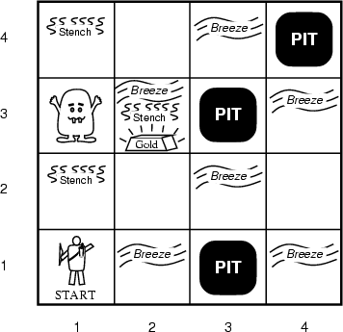
A typical Wumpus world
The agent always starts in the field [1,1].
The task of the agent is to find the gold, return to the field [1,1] and climb out of the cave.
‹#›

Slide 5
Agent in a Wumpus world: Percepts
The agent perceives
  a stench in the square containing the wumpus and in the adjacent squares (not diagonally)
  a breeze in the squares adjacent to a pit
  a glitter in the square where the gold is
  a bump, if it walks into a wall
  a woeful scream everywhere in the cave, if the wumpus is killed
The percepts will be given as a five-symbol list: If there is a stench, and a breeze, but no glitter, no bump, and no scream, the percept is
  [Stench, Breeze, None, None, None]
The agent can not perceive its own location.
‹#›

Slide 6
Wumpus actions
go forward
turn right 90 degrees
turn left 90 degrees
grab means pick up an object that is in the same square as the agent
shoot means fire an arrow in a straight line in the direction the agent is looking. The arrow continues until it either hits and kills the wumpus or hits the wall. The agent has only one arrow. Only the first shot has any effect.
climb is used to leave the cave. Only effective in start field.
die, if the agent enters a square with a pit or a live wumpus. (No take-backs!)
‹#›
Notes:
‹#›

Slide 7
Wumpus world characterization
Fully Observable No – only local perception
Deterministic Yes – outcomes exactly specified
Episodic No – sequential at the level of actions
Static Yes – Wumpus and Pits do not move
Discrete Yes
Single-agent? Yes – Wumpus is essentially a natural feature
Notes:
‹#›

Slide 8
A typical Wumpus world
The agent always starts in the field [1,1].
The task of the agent is to find the gold, return to the field [1,1] and climb out of the cave.
‹#›

Slide 9
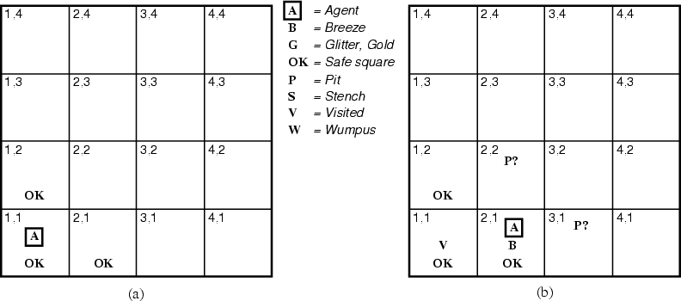
The Wumpus agent’s first step

Slide 10
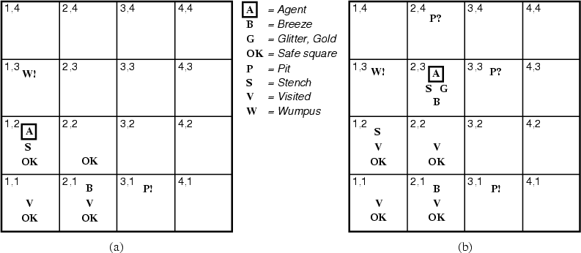
Later

Slide 11
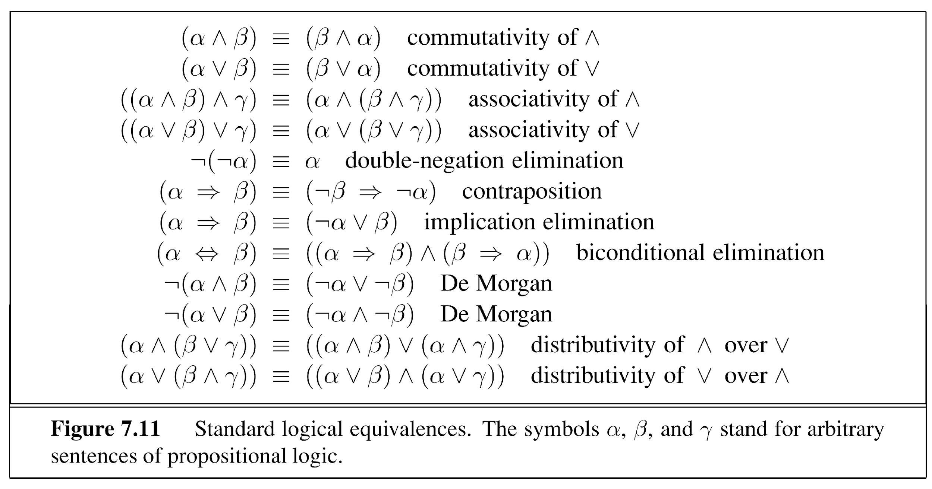
Logical Equivalences
‹#›

Slide 12
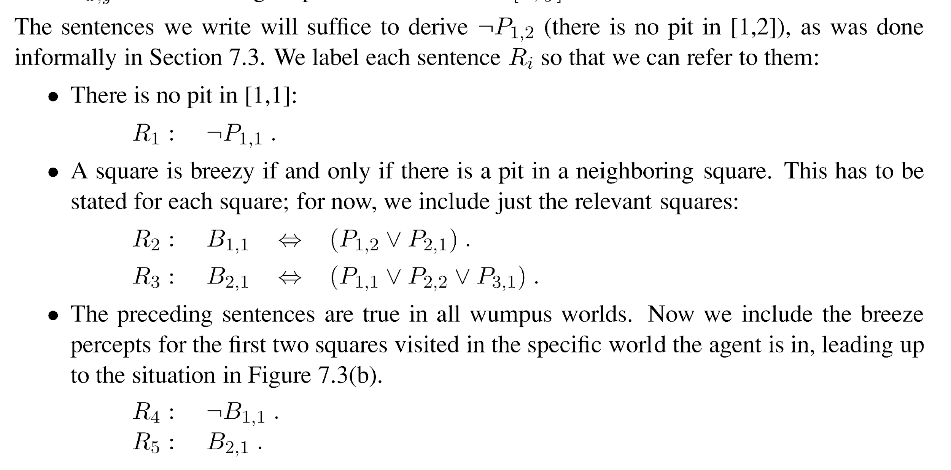
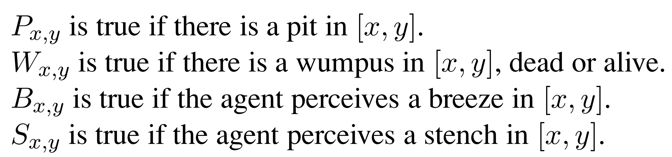
Proving no pit in [1,2]

Slide 13
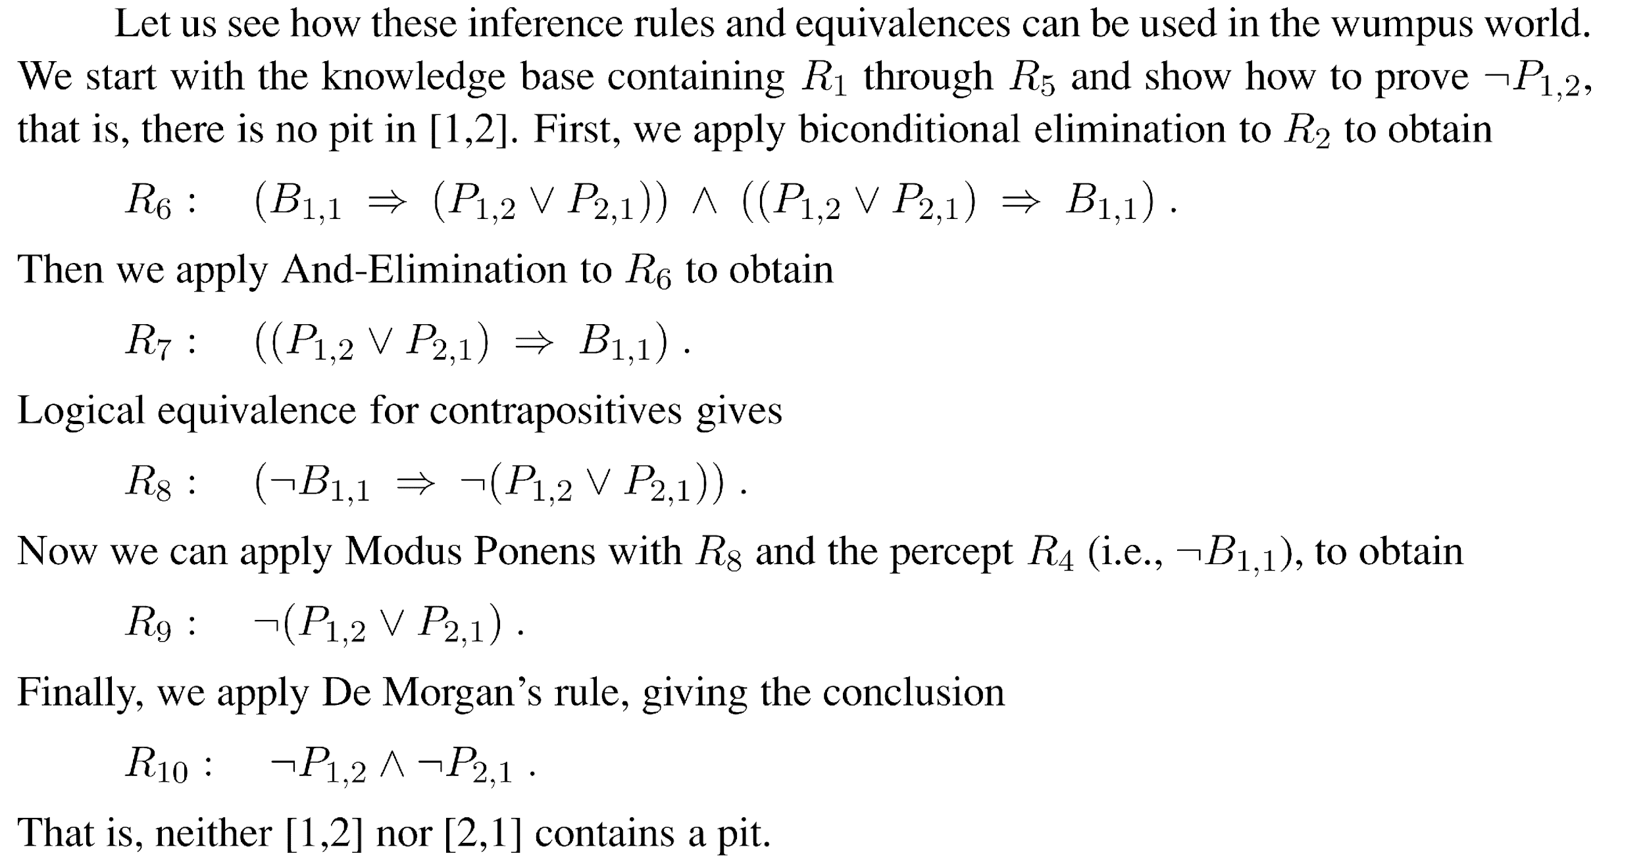
Proving no pit in [1,2]

Slide 14
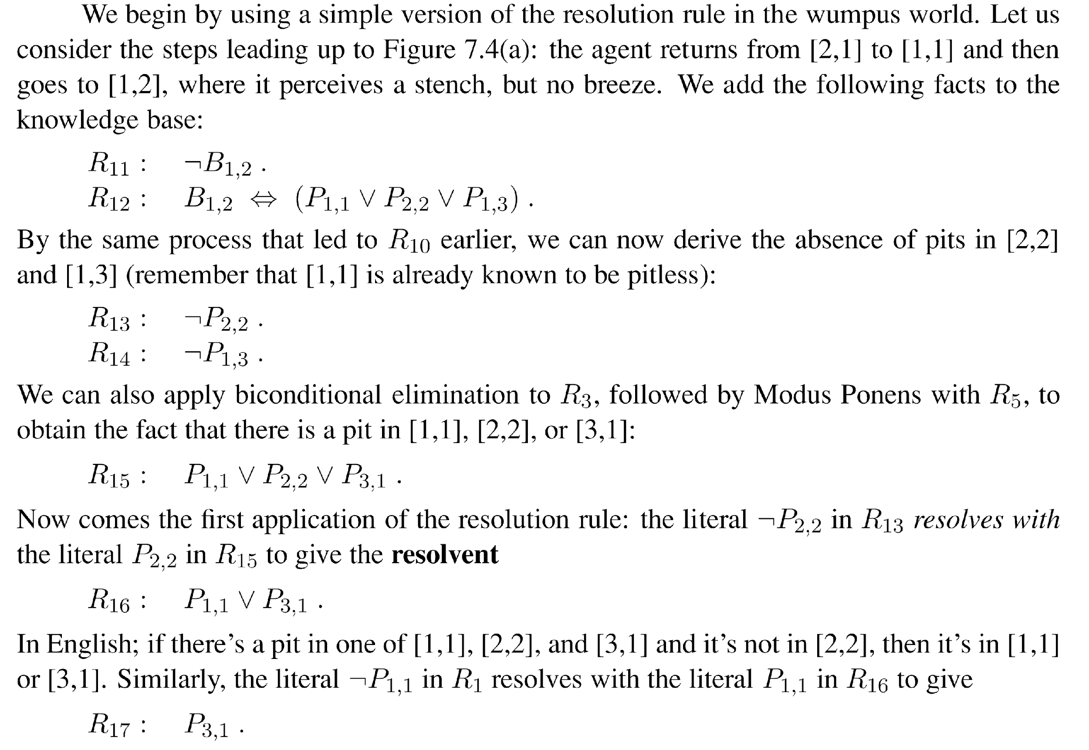
Proving pit in [3,1]

Slide 15
References
Chapter 7, Artificial Intelligence, A modern approach by Russell Norvig (3rd Edition)
https://en.wikipedia.org/wiki/Forward_chaining
https://en.wikipedia.org/wiki/Backward_chaining
https://en.wikipedia.org/wiki/Inference_engine
https://en.wikipedia.org/wiki/Production_system_(computer_science)
‹#›

